Slide 1



Class 1: Introduction to Business Intelligence
Unit I: Fundamentals of Business Intelligence
Sebastián Muñoz-Herrera, PhD.
Héctor Hormazábal

Slide 2
Schedule
UNIT I: Fundamentals of Business Intelligence (Classes 1–3)
UNIT II: Data Preparation and Predictive Models (Classes 4–7)
UNIT III: Advanced Analytics and Machine Learning Models (Classes 8–12)
UNIT IV: Ethical Communication for Decision Making (Classes 13–16)
Muñoz-Herrera and Hormazábal Class 1: Introduction to Business Intelligence Unit 1: Fundamentals of Business Intelligence

Slide 3



Evaluation
Midterm week (2)
Class Assignments
Final Exam
70%
30%
70%
30%
Muñoz-Herrera and Hormazábal Class 1: Introduction to Business Intelligence Unit 1: Fundamentals of Business Intelligence

Slide 4
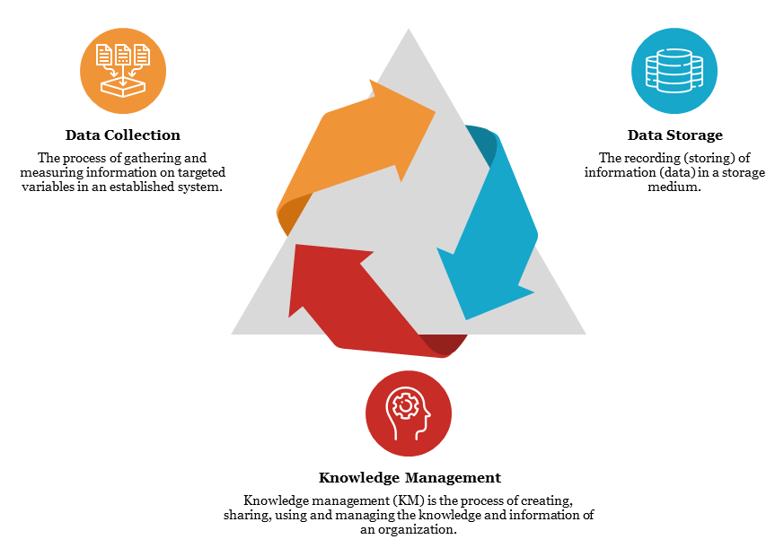
Business Intelligence – Core Concept
Business intelligence (BI) is a data-driven DSS that combines data gathering, data storage,
and knowledge management with analysis to provide input to the decision process.
Muñoz-Herrera and Hormazábal Class 1: Introduction to Business Intelligence Unit 1: Fundamentals of Business Intelligence

Slide 5



Business Intelligence – Why Does BI Matter?
The problem | The BI Solution | Result
Thousands of daily routes, weather disruptions, customs delays, and fuel costs — impossible to manage manually | Real-time data from GPS, weather APIs, customs systems, and customer demand fed into predictive models | 15 % reduction in fuel costs, fewer delays, and dynamic rerouting in real time
Store managers ordering inventory by instinct, massive overstock and stockouts, no visibility across regions. | Retail Link: a BI system connecting all suppliers, stores and distribution centers in real time. Every sale, every shelf, every truck — tracked. | Inventory costs cut by 20%, suppliers got direct access to their own sales data, and Lider overtook Sears as #1 retailer in Chile
Hundreds of simultaneous chemical processes, extreme temperatures and pressures, thousands of variables changing every second — impossible for humans to monitor manuallyS | platform integrates sensor data, process historians, and real-time BI dashboards to monitor every unit, flag anomalies, and optimize throughput automatically | 5-8 % increase in refinery yield, 30% reduction in unplanned shutdowns, and real-time visibility across global operations from a single control room
Muñoz-Herrera and Hormazábal Class 1: Introduction to Business Intelligence Unit 1: Fundamentals of Business Intelligence

Slide 6
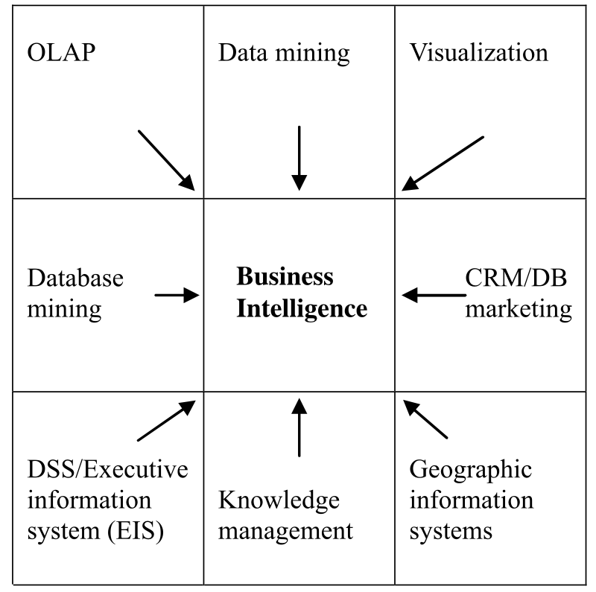

Business Intelligence – Core Concept
Business intelligence is the result of a series of innovations over the years
Muñoz-Herrera and Hormazábal Class 1: Introduction to Business Intelligence Unit 1: Fundamentals of Business Intelligence

Slide 7
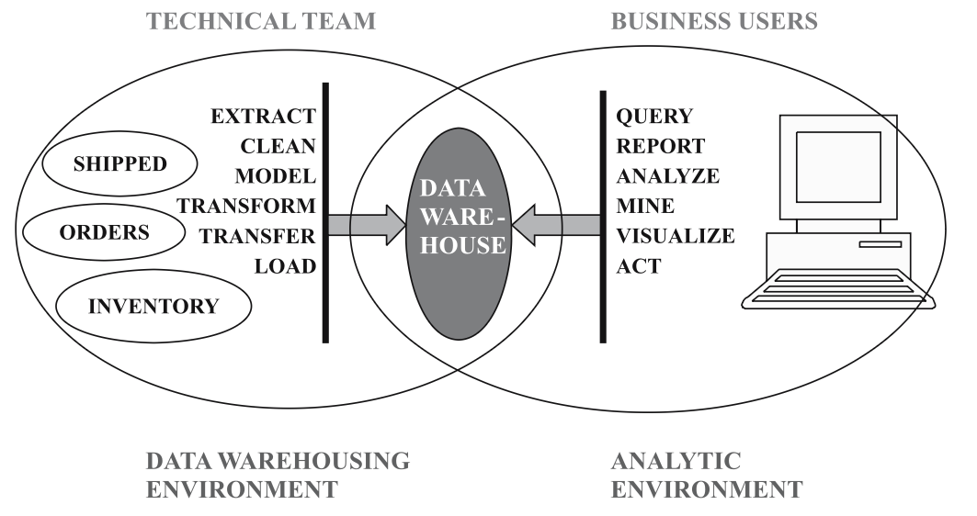
Business Intelligence – Role of Warehouse Storage
A data warehouse is a large database. It is defined as a subject oriented, integrated, time variant, non-volatile, collection of data in support of management decission processes
Muñoz-Herrera and Hormazábal Class 1: Introduction to Business Intelligence Unit 1: Fundamentals of Business Intelligence

Slide 8
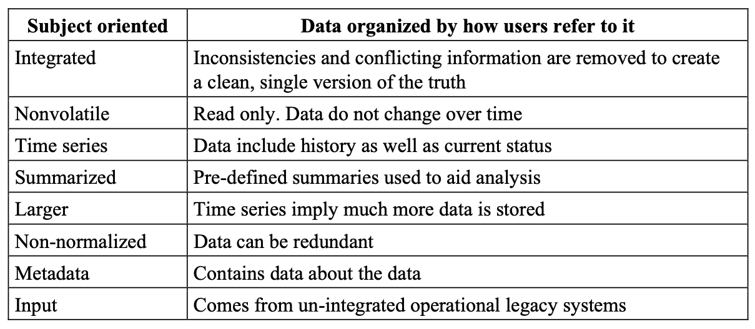
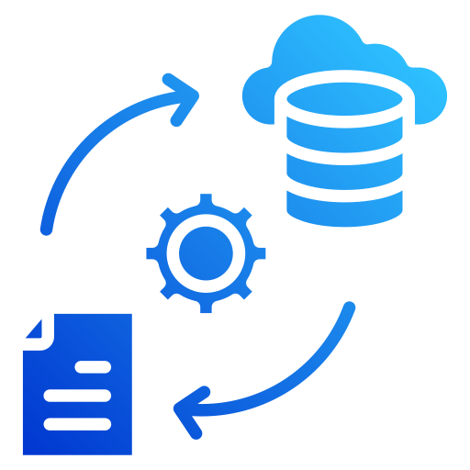
Business Intelligence – Data Warehouse Characteristics
(traditional)
***
Muñoz-Herrera and Hormazábal Class 1: Introduction to Business Intelligence Unit 1: Fundamentals of Business Intelligence

Slide 9

Business Intelligence – Data Analytics
Descriptive analytics
"What happened?" Summarizes historical data through reports and dashboards to understand past performance. The most common and foundational type of analytics.
Predictive analytics
"What will happen?" Uses statistical models and machine learning to forecast future outcomes, such as customer churn or demand forecasting.
Analytics plays a central role in Business Intelligence (BI) by transforming raw data into actionable insights that support decision-making.
Prescriptive analytics
"What should we do?" Recommends specific actions to achieve desired outcomes using optimization models and AI-driven decision tools.
Muñoz-Herrera and Hormazábal Class 1: Introduction to Business Intelligence Unit 1: Fundamentals of Business Intelligence

Slide 10
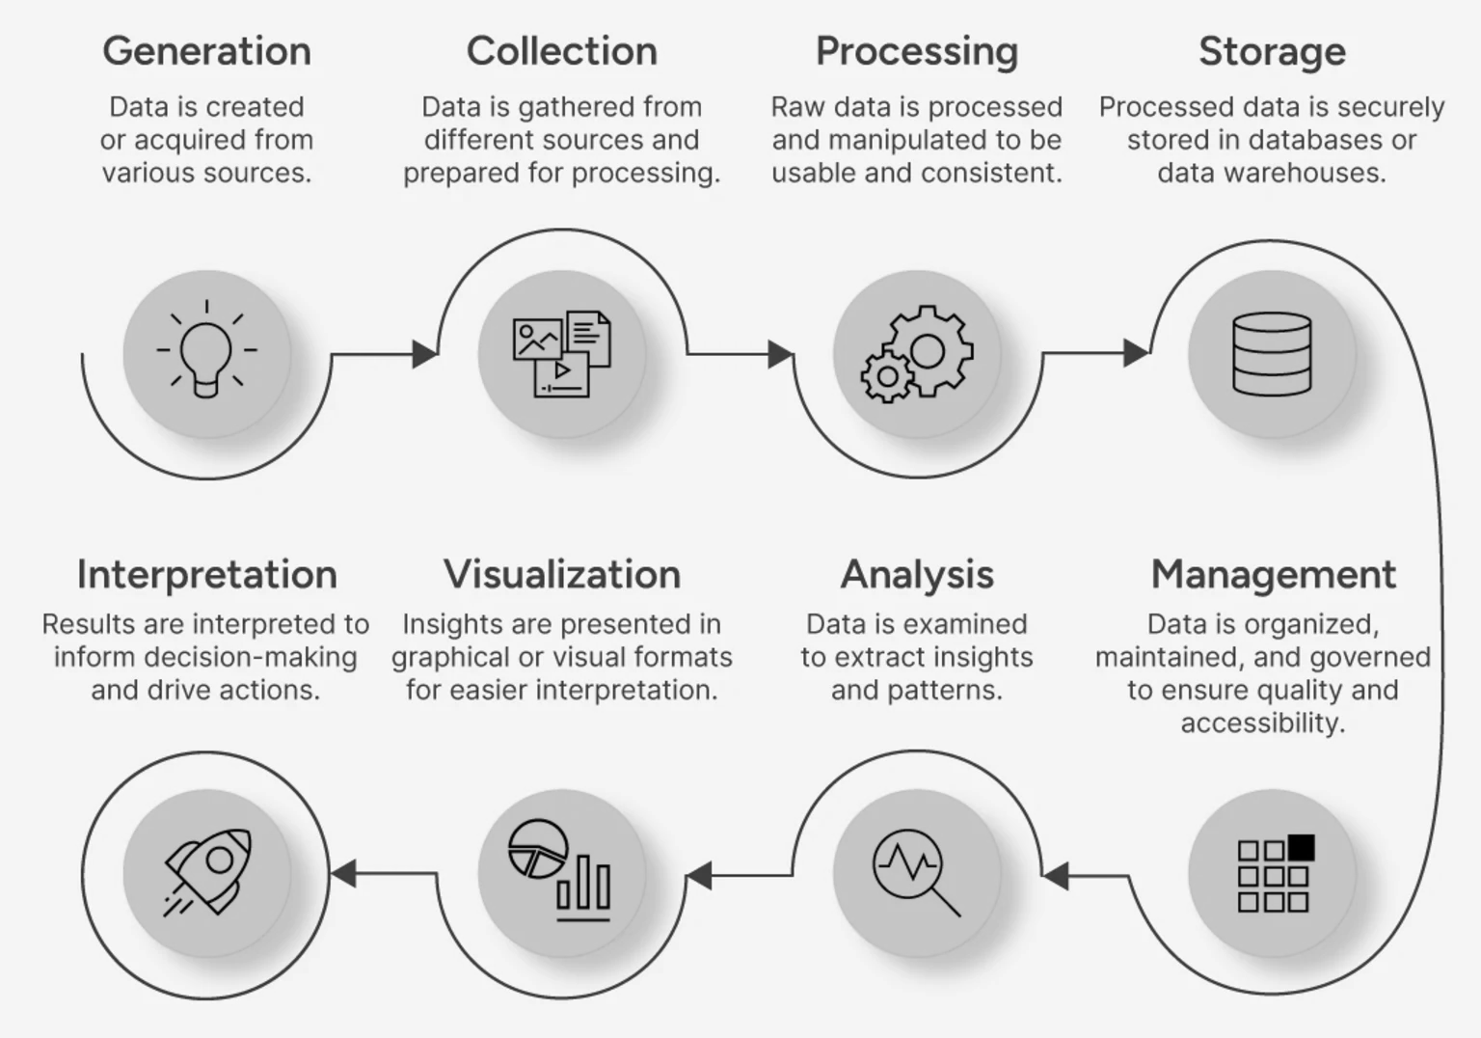
Business Intelligence – Data Cycle
Muñoz-Herrera and Hormazábal Class 1: Introduction to Business Intelligence Unit 1: Fundamentals of Business Intelligence

Slide 11
Business Intelligence – BI Ecosystem
Layer | What It Is | Real Examples
Data Sources | Where raw data lives — structured and unstructured | ERP systems, IoT sensors, CRM, social media, web logs, spreadsheets
ETL / ELT | Extract, Transform, Load — cleans and moves data into storage | Apache Spark, Talend, dbt, AWS Glue
Data Warehouse | Central, organized repository for historical and current data | Snowflake, Google BigQuery, Amazon Redshift, Azure Synapse
Analytics Engine | Where data gets interrogated — from SQL queries to ML models | Python, R, SAS, Databricks
Visualization Layer | Translates numbers into insight humans can act on | Power BI, Tableau, Looker, Grafana
Decision | The whole point — faster, smarter, evidence-based action | C-suite dashboards, operational alerts, automated triggers
Muñoz-Herrera and Hormazábal Class 1: Introduction to Business Intelligence Unit 1: Fundamentals of Business Intelligence

Slide 12
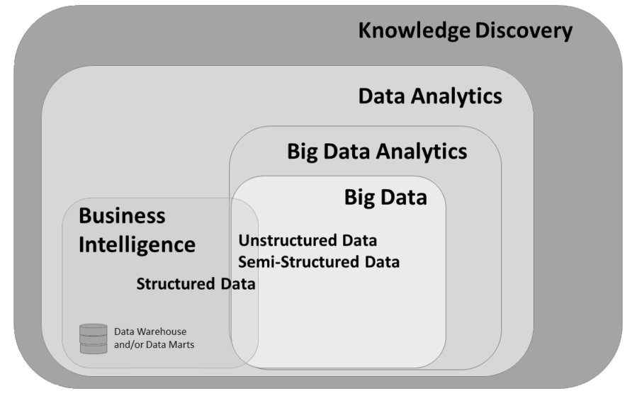
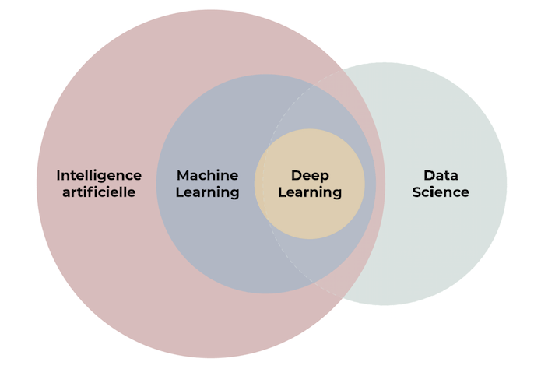
Some concepts differentiation
Muñoz-Herrera and Hormazábal Class 1: Introduction to Business Intelligence Unit 1: Fundamentals of Business Intelligence

Slide 13

Practical Section
Google Colab — First steps
Variables, lists, dictionaries, loops, functions
Load a CSV, explore it, filter it, sort it
One chart with matplotlib or seaborn — histogram or bar chart
Students modify the notebook solo: change filter, add a column, re-plot
Muñoz-Herrera and Hormazábal Class 1: Introduction to Business Intelligence Unit 1: Fundamentals of Business Intelligence

Slide 14
Class 1: Introduction to Business Intelligence
Unit I: Fundamentals of Business Intelligence
Sebastián Muñoz-Herrera, PhD.
Héctor Hormazábal

